Slide 1

Computational Intractability:
P vs. NP & The Travelling Salesman Problem
Educational Overview

Slide 2



What are
P and NP Classes?
NP
solutions verifiable
in polynomial time
P: problems solvable in polynomial time by a deterministic Turing machine
NP: problems whose solutions can be verified in polynomial time by a deterministic Turing machine
P
solvable in
polynomial time
P is a subset of NP, but whether
P equals NP is unknown.

Slide 3

The P vs. NP Question
P
Is P equal to NP?
np
Whether every problem whose solution can be quickly verified can also be quickly solved
?=
One of the biggest unresolved questions in computer science and mathematics

Slide 4


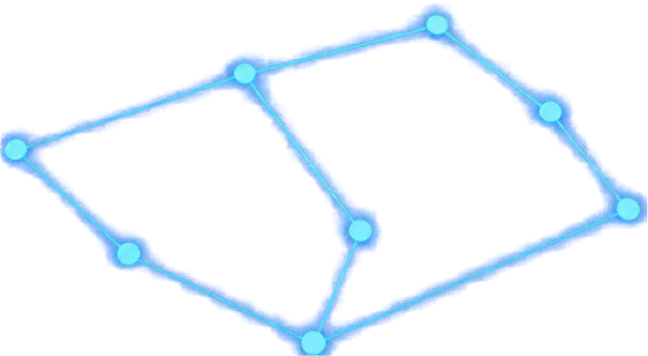
The Travelling
Salesman Problem (TSP)
Find the shortest possible route visiting each city exactly once and returning to the start
TSP is NP-hard
No known polynomial-time algorithm
Real-world relevance
Logistics, route planning, optimization

Slide 5





NP-Hard and NP-Complete
NP-Hard
at least as hard as
NP-Complete problems
NP-Complete problems are in NP and as hard as any other in NP; if one is in P, then P=NP.
NP
NP-Hard problems are at least as hard as NP-Complete problems but may not
be in NP.
NP-Complete
The decision version of TSP is NP-Complete. The optimization version of TSP is NP-Hard.
P
Other examples include the Minimum Vertex Cover (MVC) problem

Slide 6


Thank you.
Questions?
P vs. NP remains unresolved
P vs. NP
The Travelling Salesman Problem exemplifies computational intractability
Understanding complexity classes is essential to computer science
Presentation content generated using Canva Magic Design

